Slide 1

AN EXTENSIVE COMPARATIVE STUDY OF CLUSTER VALIDITY INDICES
V Anvesh Raju (20MCMI19)
M.Tech (Artificial Intelligence)
School of Computer and Information Sciences
University of Hyderabad
Under the guidance of
Dr. Avatharam Ganivada
February 18, 2022

Slide 2
Overview
Introduction
The Cluster Ensemble Problem
Cluster Validity Indices
Problem Statement
Procedure
Conclusion and Future work
References

Slide 3
Introduction
Clustering is an unsupervised pattern classification method that partitions the input space into clusters.
The goal of a clustering algorithm is to perform a partition where objects within a cluster are similar and objects in different clusters are dissimilar.
Widely used in Psychology, Biology, Pattern recognition, Image Processing and Computer Security.
Process of estimating how good a partition fit the data underlying is Cluster Validation.

Slide 4
Continued……
How well the data fit into the proposed partition?
Relevant For two reasons:
First, an optimal clustering algorithm does not exist
Second, many clustering algorithms are not able to determine the number of clusters in the data, therefore we have to supply the initial values - commonly known as k-parameter. (Run the algorithm several times with a different k-value for each run).

Slide 5
The Cluster Ensembles Problem
It is based on sample’s stability and objective of clustering ensemble is to find the underlying structure of data based on set of clustering results.
CE algorithm based on sample’s stability which divides into two classes : 1) Cluster core and 2) Cluster Halo.
CE problem mainly includes 3 aspects: Ensemble generation, ensemble selection and Ensemble integration.
Suppose X = {x1,x2,.....,xn} is a data set with n samples. After performing different clustering methods, a set C = {C1,C2,.....,Cj} where j is the ensemble size and indicates number of clusterings.
Ci(xi) indicates the label of xi induced by cluster result Ci.

Slide 6
Continued….
The objective is to find a new clustering result C* which is similar to every element in C.
Diversity and accuracy are the two key factors to the performance of ensemble techniques.
Ensemble selection technique, inspired by feature selection technique is proposed to improve the quality of the obtained clustering results set. It selects a subset of results based on a pre-defined principle which is helpful for integration step.

Slide 7
Contd…..( Sample’s stability in CE)
Given a set of base clustering results, some samples remain consistently in one group, while others frequently change from one group to another. This tendency is helpful for many tasks in CE, such as measuring the quality of the set of base clustering results and differentiates a cluster halo and cluster core.
A methodology to measure the sample’s stability :
Determinacy function: f is a determinacy function if for arguments p ∈ [0,1] and with a parameter t ∈ (0,1), it satisfies:
(1)If p <t, f(p) <0; if p >t, f(p) >0.
(2)If pi<t<pj, and t−pi / pj−t = t / 1−t, f(pi) = f(pj).

Slide 8


Contd….
Stability based on linear function:
The linear-based stability of sample xiis quantized based on the agreement degree of its relations with the other samples, which is calculated by
(4)

Slide 9
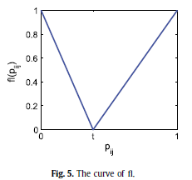
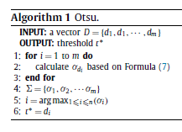
Contd…..
To learn a threshold t, we solve a linear discriminant problem using Otsu algorithm [53]. Suppose D ={d1, d1, ···, dm}is a vector with m elements. A threshold ˜t can divide D into two groups g0and g1by:
g0 = {di : di < ˜t, 1 i m}, (5)
g1 = {di : di ˜t, 1 i m}. (6)

Slide 10


Contd….
Stability based on quadratic function:
we consider a simple determinacy mapping function, the quadratic function, which is defined by:
The curve of the quadratic function fq is shown in Fig.6.
With fq, the stability of sample xi is calculated by:
(10)

Slide 11
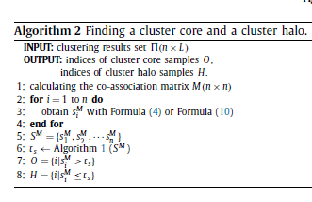
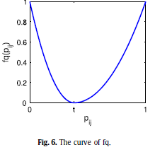
The stability of each sample can be calculated based on Formula (4)or Formula (10). With these stability values, the cluster core and the cluster halo can be determined by a threshold.

Slide 12
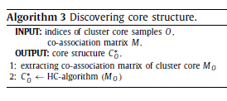
After determining the cluster core and cluster halo, the processes of handling samples in these two parts are quite different. For the cluster core, one may hope to find a clear underlying structure. With this structure, the assignments of the samples in the cluster halo can be carried out.

Slide 13
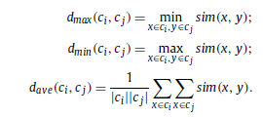

Discovering the structure of a cluster core:
The stability of a sample is determined by the co-association matrix. In order to reduce the amount of computation, the co-association matrix should be employed to discover the structure of a cluster core. Any clustering algorithms based on the co-association matrix can be applied to discover an underlying structure of cluster core. Here, we use the hierarchical clustering (HC) algorithm.

Slide 14
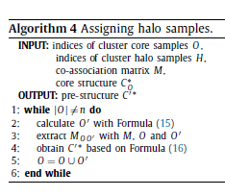
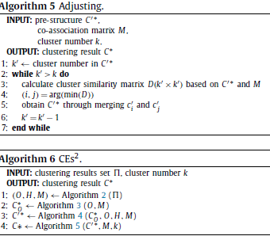
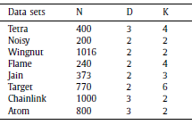

Slide 15
Cluster Validity Indices
We describe the CVIs as they are used to estimate the number of clusters in a set of datasets partitioned by several algorithms.
We use some of indices:
Dunn Index(DI)
Calinski-Harabasz(CH) etc.,
Finding suitable index is the final goal.

Slide 16
Problem Statement:
There are several kind of cluster validity indices. However, identifying the most suitable index for a possible application is an important problem of cluster validation. This is possible to compare a set of validation indices on different number of synthetic data sets. This objective is to conduct different experiments on evaluating clustering solutions of different cluster methods using existing cluster validity indices.

Slide 17
Procedure
The usual approach is to run a clustering algorithm over a dataset with a set of different values for the k parameter — the number of clusters of the computed partition — obtaining a set of different partitions. Then, the evaluated CVI is computed for all the partitions. The number of clusters in the partition obtaining the best results is considered the prediction of the CVI for that particular dataset. If this prediction matches the true number of clusters, the prediction is considered successful.
But here we use this approach to predict which is the ‘‘best’’ partition in the mentioned set of partitions. The ‘‘best’’ partition is defined as the one that is the most similar to the correct one—measured by a partition similarity measure—which is not always the one with the correct number of clusters.

Slide 18
Conclusion and Future Work
In this paper, we use Cluster Ensemble approach to find the suitable validity indices which makes clustering into groups effectively on different synthetic datasets and produce results.
With regard to the experimental factors, noise and cluster overlap had the greatest impact on CVI performance.

Slide 19
References
[1]M. Halkidi, Y. Batistakis, M. Vazirgiannis, On clustering validation techniques, Journal of
Intelligent Information Systems 17 (2001) 107–145.
[2]C.-H. Chou, M.-C. Su, E. Lai, A new cluster validity measure and its application to image compression,
Pattern Analysis and Applications 7 (2004) 205–220.
[3]A.K. Jain, R.C. Dubes, Algorithms for Clustering Data, Prentice-Hall, Inc., Upper Saddle River, NJ, USA, 1988
[4]P.H.A. Sneath, R.R. Sokal, Numerical Taxonomy, Books in Biology, W.H. Freeman and Company, San Francisco, 1973
[5]V.Batagelj, M.Bren, Comparing resemblance measures,JournalofClassification 12(1995)73–90.

Slide 20
Thank you

